Slide 1
Roll the Dice
Sadath alam

Slide 2
Objective
To create an UI for dice game
Button to roll dice
Rules of the game
Section for player names, and score
Number of turns each player has remaining

Slide 3
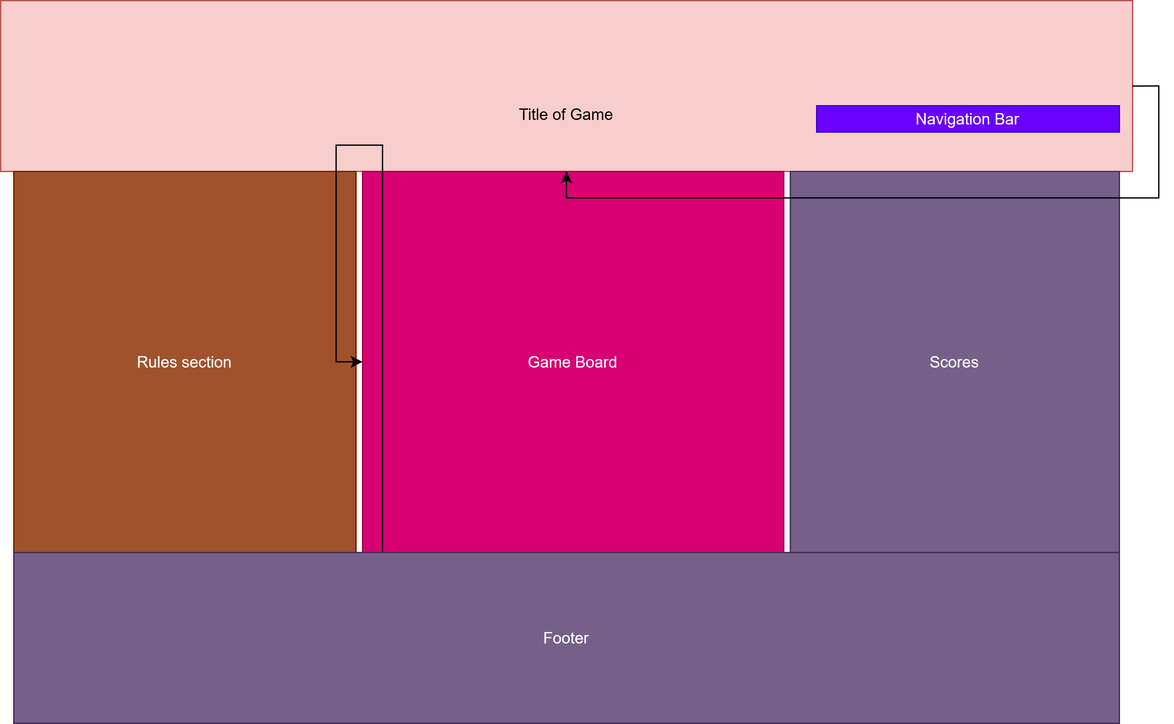
Design
Webpage should contain header, main body under header, and footer
Header should include title and navigation bar
Footer section with information such as game name, developer name, etc..
Body separated into three parts horizontally
-Rules section
-Main gameboard section with button to roll dice
-Scores section

Slide 4
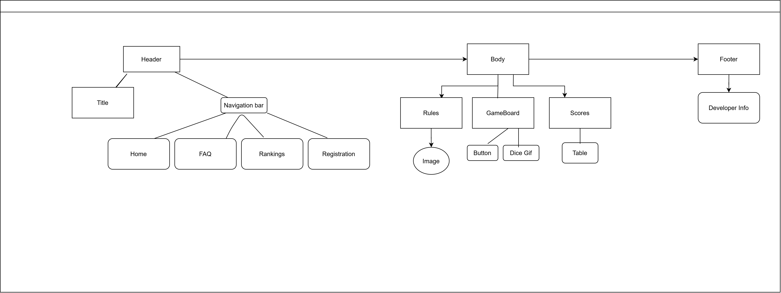
UML Class Diagram

Slide 5
Key Design Features
Transition
-Used on the Roll button
-When mouse hovers hover it, it becomes wider
Animation
-Used on the table under Scores section
-Used to display the winner of the game by highlighting the player name in blue
Translate
-Used on the smiley face image under Rules section to scale picture 0.5 of its original size
-Also used to move div box to desired position

Slide 6
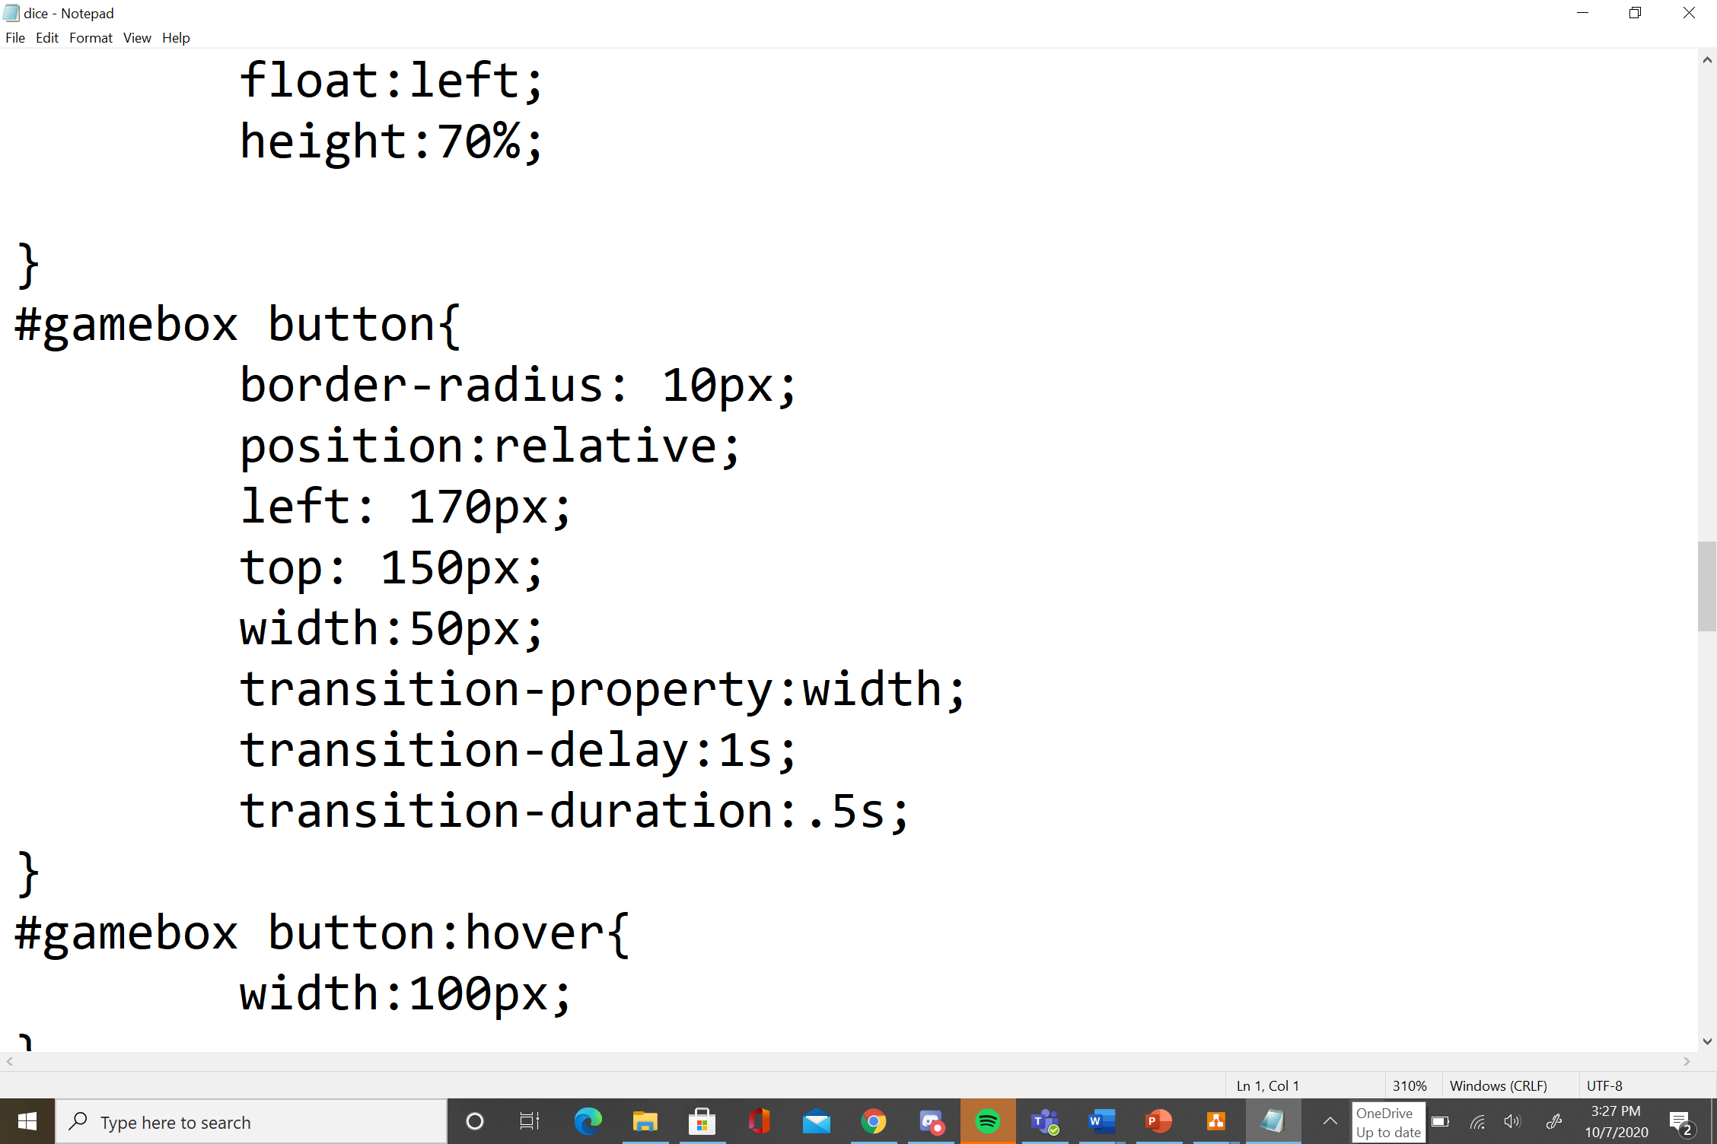
Transition

Slide 7
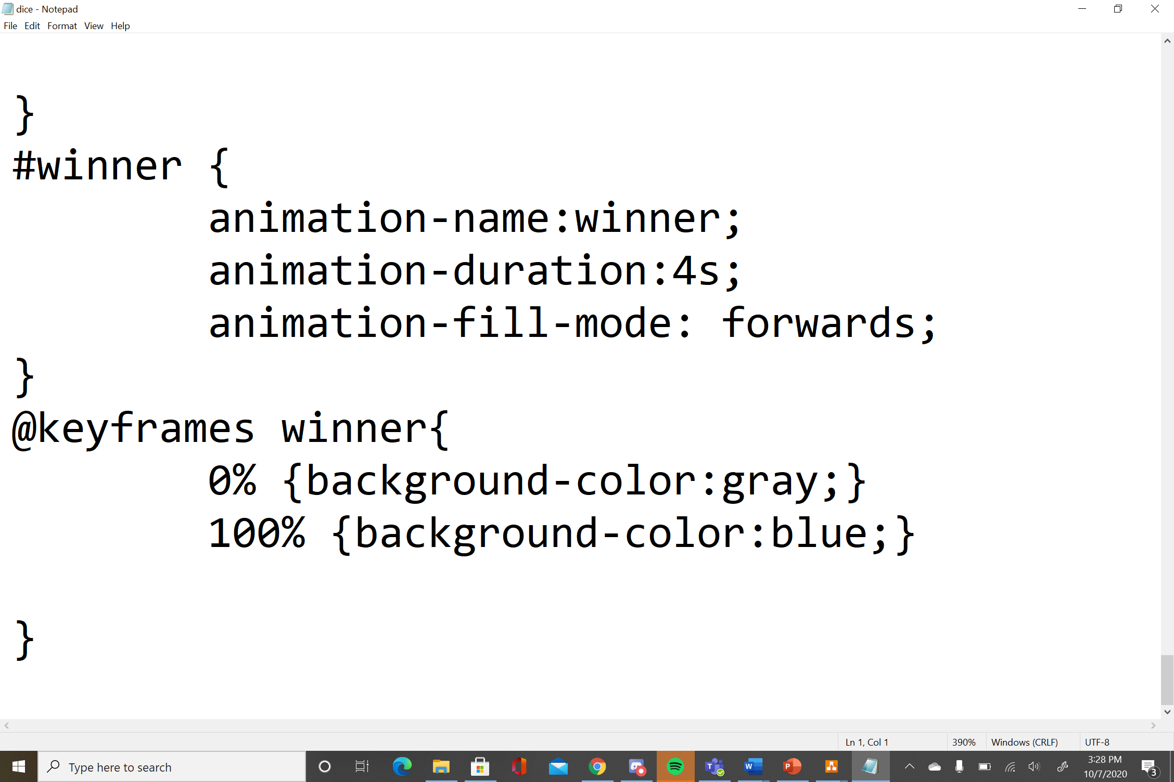
Animation

Slide 8
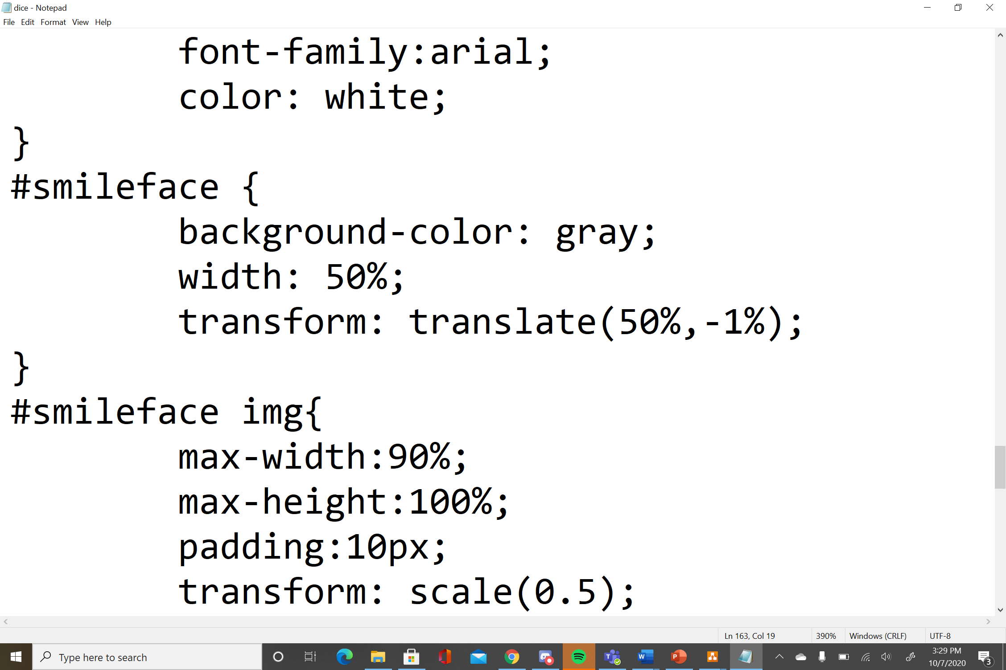
Translate

Slide 9
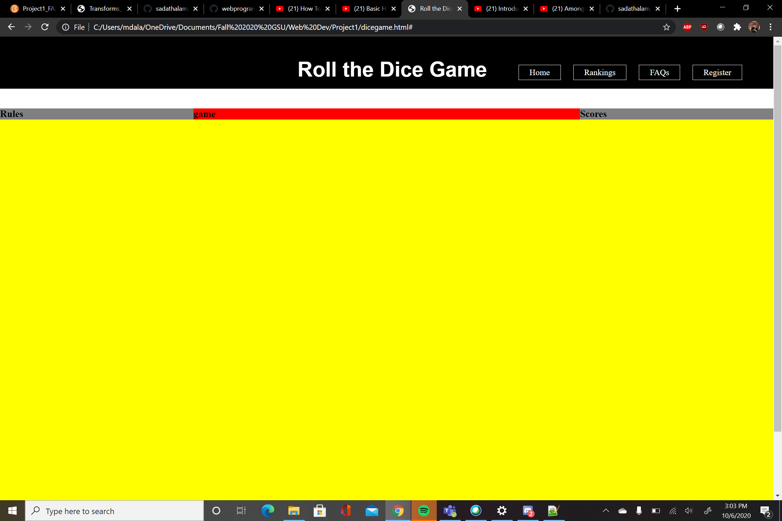
Problems
Time management and work- load
White space between header and body
Giving button an action when pressed

Slide 10
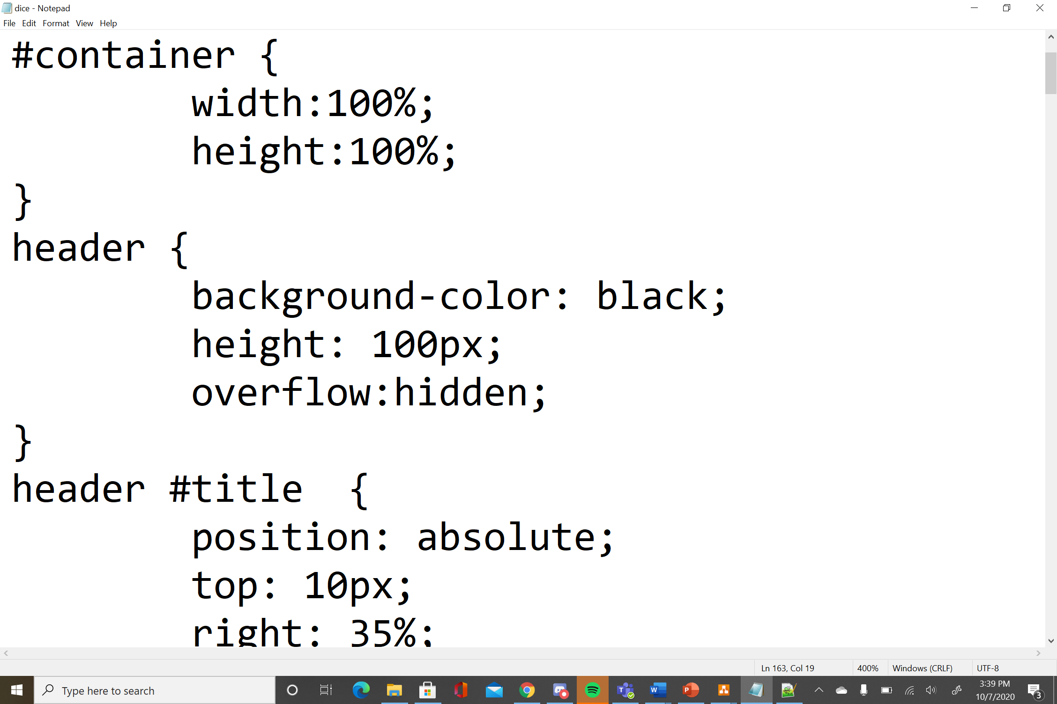
Solution
Divide the workload between 3 days
-1st day: Sketch out a basic design of webpage/ think of game
-2nd day: Start developing webpage/ test
-3rd day: Documentation
Use overflow property to get rid of whitespace
Could not give button an action by only using HTML and CSS so opted to use dice gif to give effect of player rolling dice, could implement in the future

